Slide 1
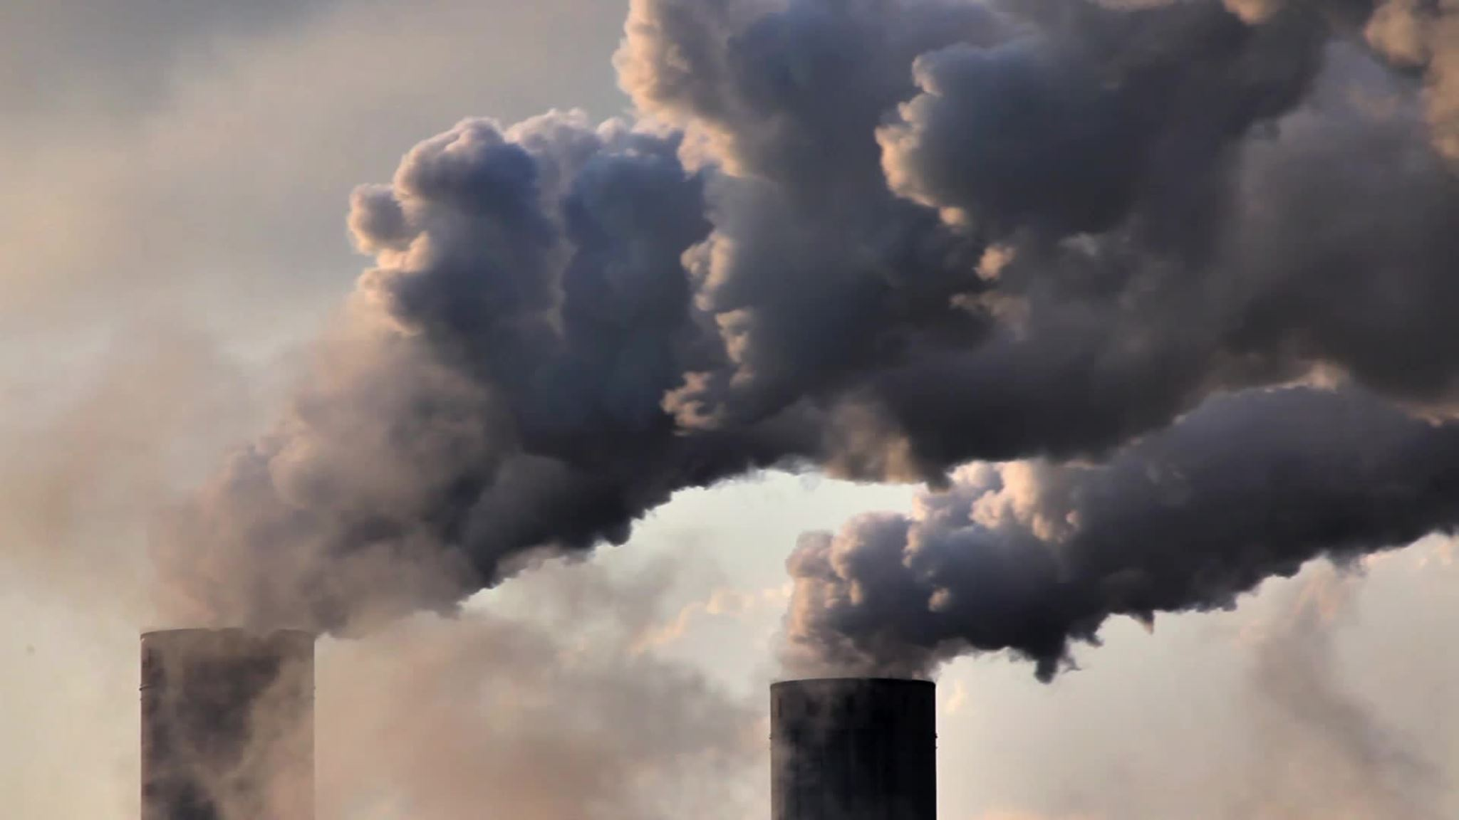
Analyzing CO2 Emissions -27/11/2023
Shashank HV
Sakthi Vel S
Pankaj Chouhan

Slide 2
Problem statement
Analyze carbon emission data to identify trends, evaluate the impact of policies.
Objective
Identify trends,evaluate the impact of policies, and suggest recommendations for reducing carbon footprints.

Slide 3



INSGITHS:
Rise in the Carbon Emission should Directly proportional to population
In Countries like USA,UK,Germany,Korea,Cannda and other countries does not fall in this trend
The Population should be major factor for rise or fall in carbon emission has been changed

Slide 4
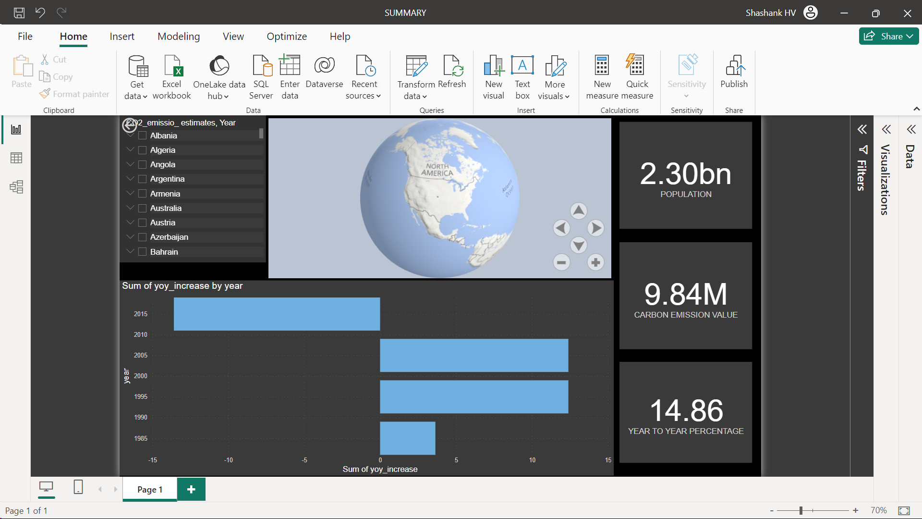
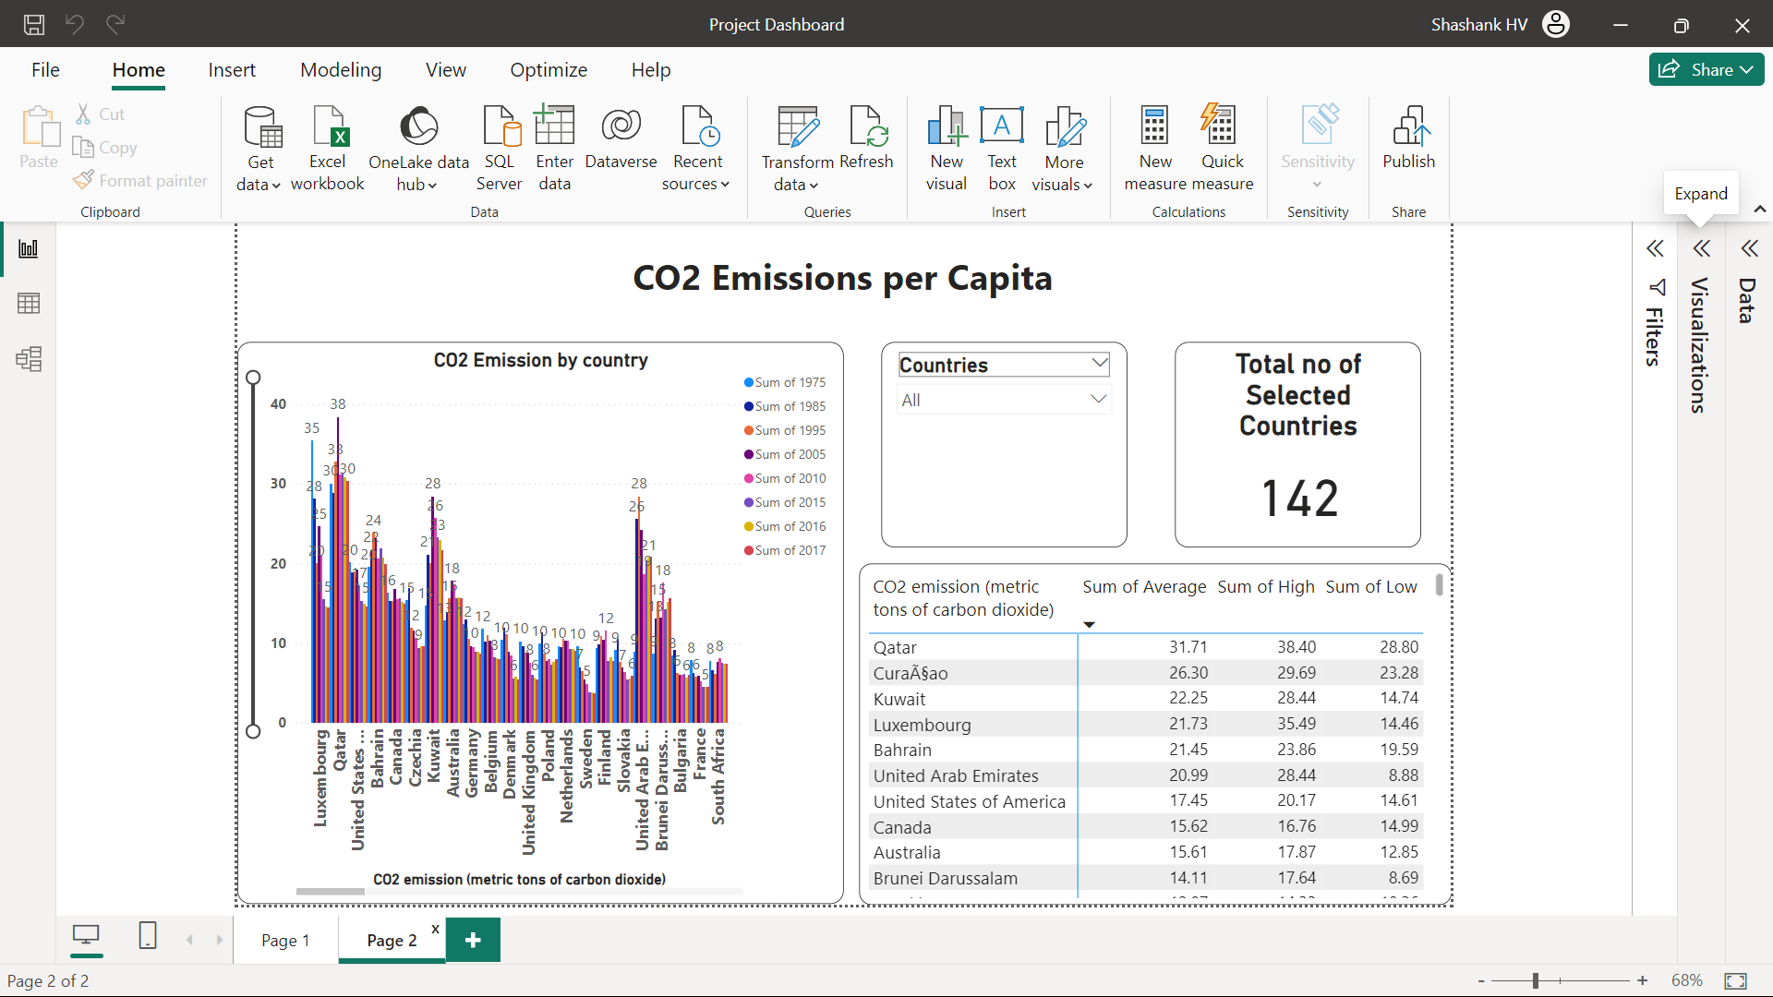
DASHBOARD

Slide 5
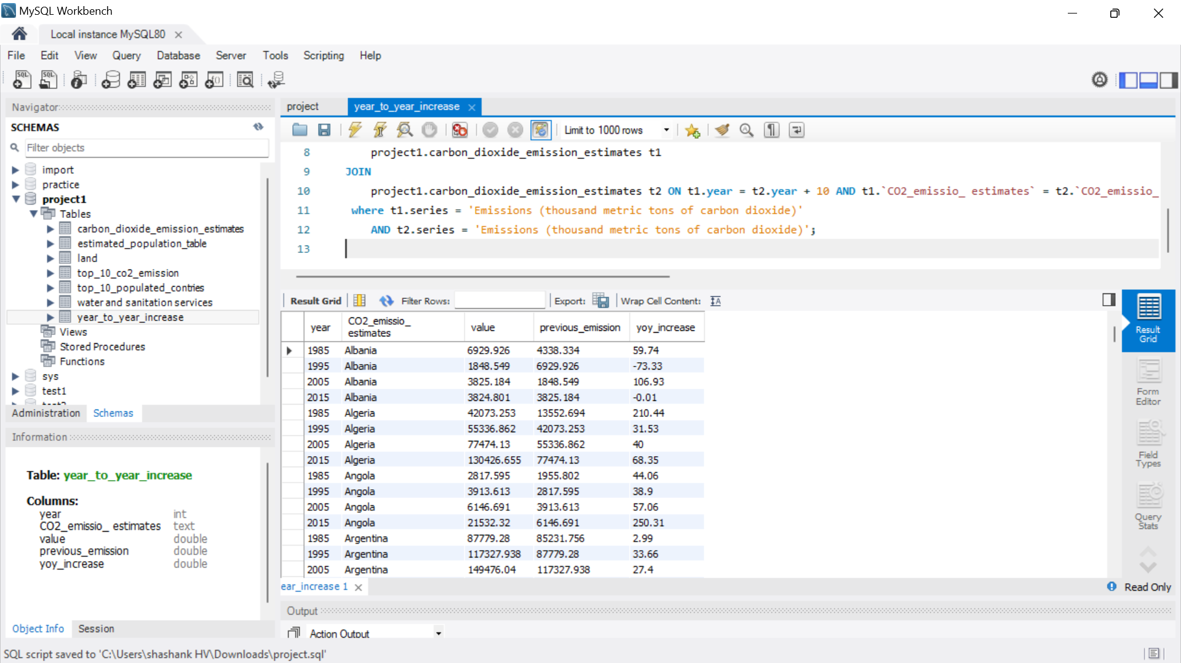
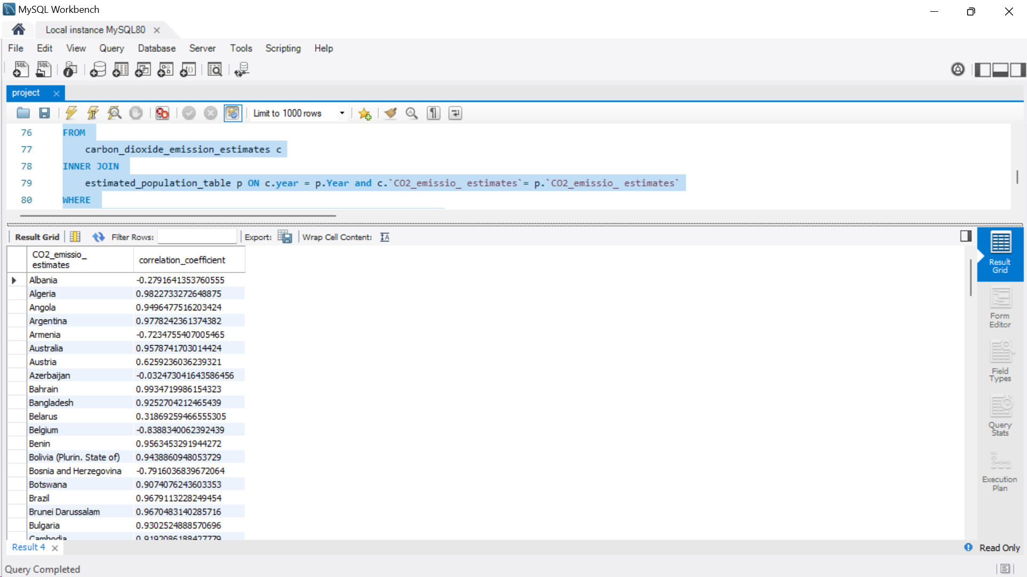
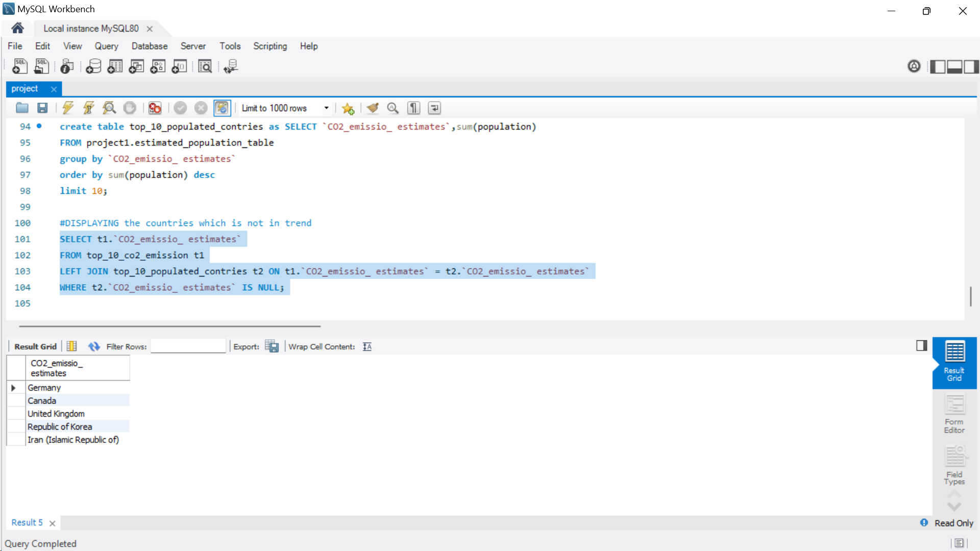
RESULT:
YEAR TO YEAR INCREASE PERCENTAGE CALCULATION
CORELATION BETWEEN POPULATION AND EMISSION
SAMPLE OF COUNTRY NOT IN TREND

Slide 6
CONCULSION
Reducing carbon emissions is critical for combating climate change. Transitioning to renewable energy, sustainable practices, and global collaboration is essential for a sustainable future.

Slide 7
FUTURE SCOPE
We need advancing renewable technologies, fostering global cooperation, and implementing sustainable policies to further reduce carbon emissions for a resilient and sustainable planet.

Slide 8
THANK YOU

